Slide 1
Issue: Validation loss increases and is greater than initial validation loss, but the validation accuracy is significantly greater than the initial validation accuracy.
Steven Cao
03/25/2022

Slide 2
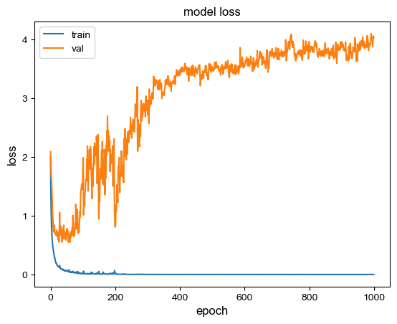
Problem
Loss increases after training and is greater than the initial loss.
Conclusion:
There is a problem. The validation loss for the 1000th epoch is greater than that of the initial loss, which is not what we want because it shows that the model is not learning.
Manually get the accuracy, precision, recall, and f1 score for each subject for the initial model, the best model, and the last model to confirm our observations.

Slide 3
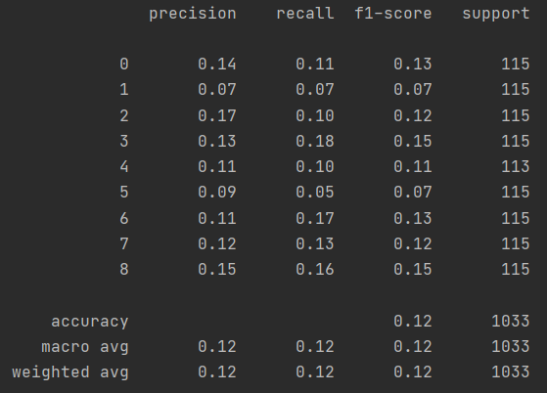
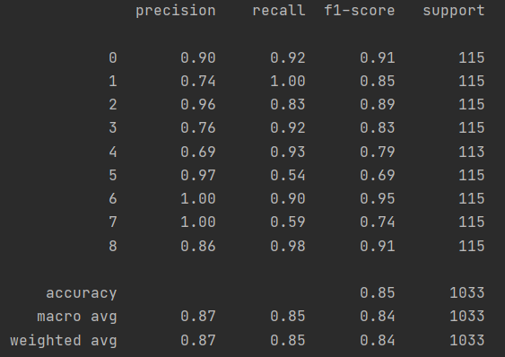
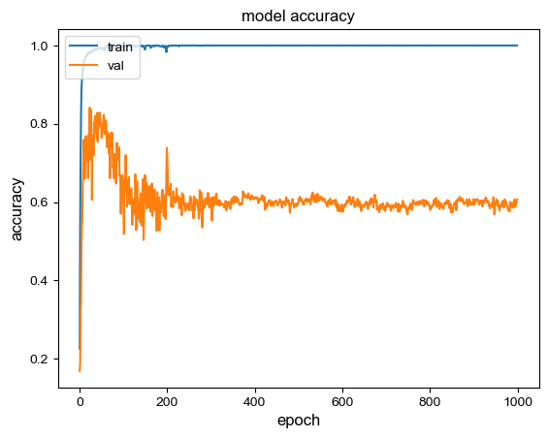
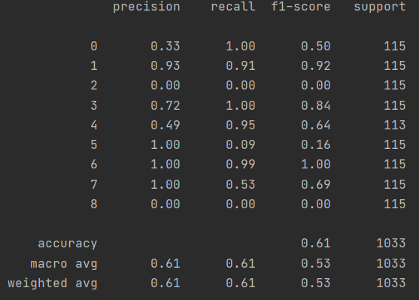
The results of a few metrics
3
1:
Conclusion:
The results from a few metrics shows that the validation accuracy is greater than the initial validation accuracy. This does not support our observation that the model isn’t learning.
Lets see if there is anything wrong with calculating the categorical cross-entropy loss.
1
2
2:
2
3:
3
1

Slide 4
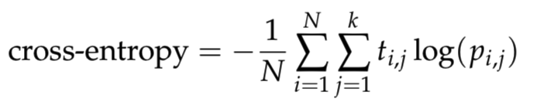
Calculating categorical cross-entropy
losses = [] for label, pred in zip(y_true_hot, y_pred): pred /= pred.sum(axis=-1, keepdims=True) losses.append(np.sum(label * -np.log(pred), axis=-1, keepdims=False)) print(losses) print(np.mean(losses))
Cross-Entropy loss
1: model : 2.08882737159729 ; my calculation: 2.197060735389547
2: model : 0.54115468263626 ; my calculation: 0.5411547039803284
3: model : 4.026108644442618 ; my calculation: 4.026108644442618
Conclusion:
There is nothing wrong with the model calculating the loss.
Notes:
.

Slide 5
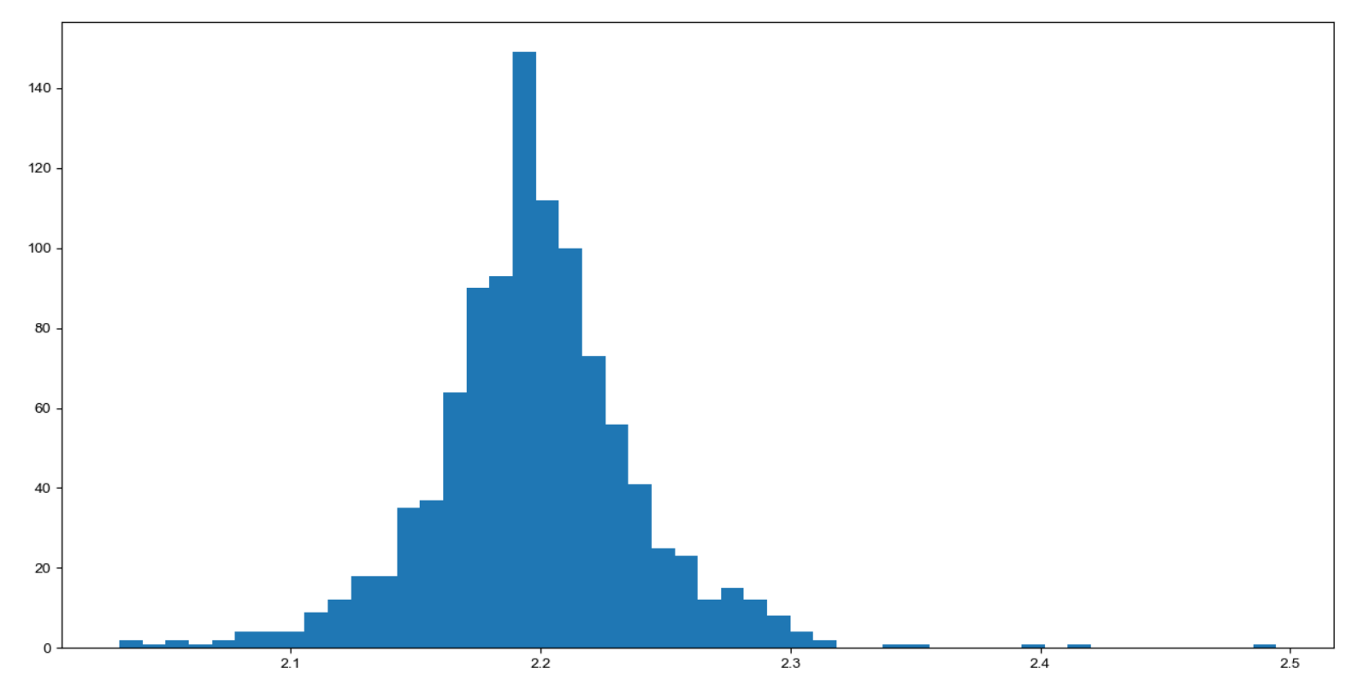
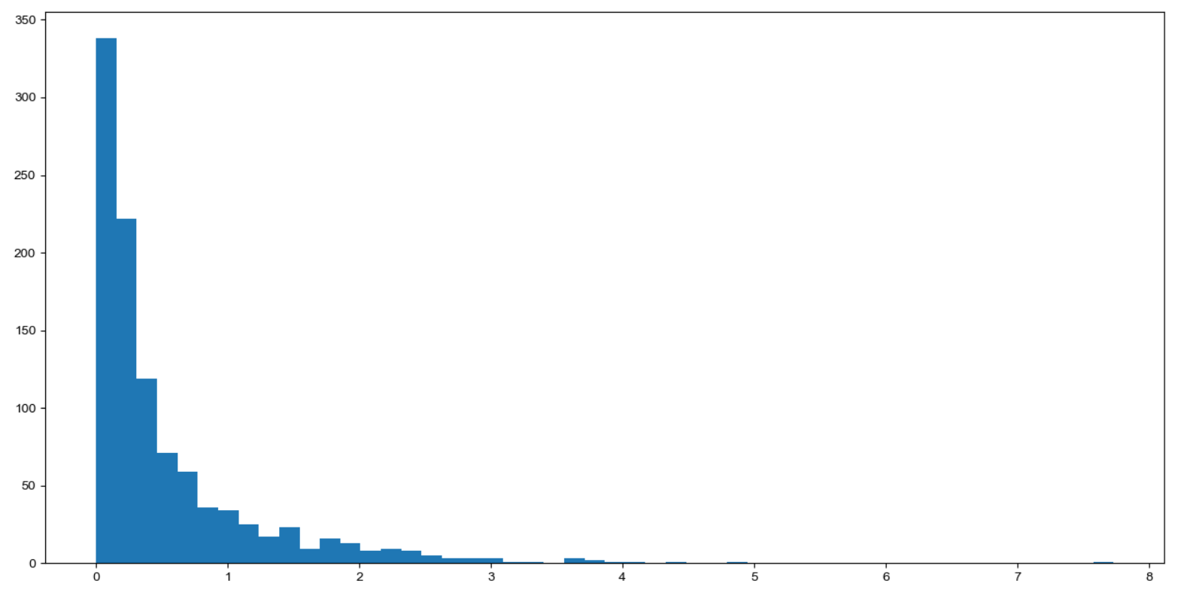
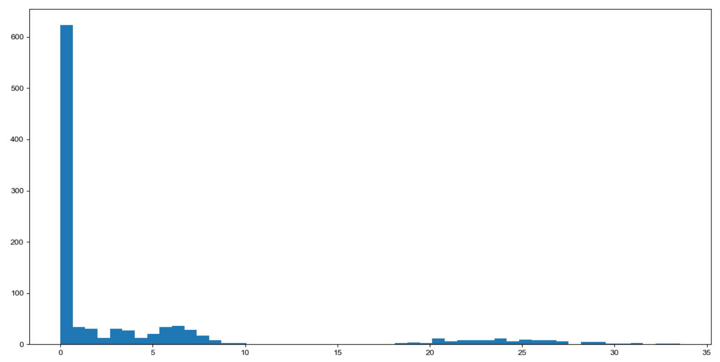
The distribution of the losses
Model 1
Model 2
Model 3
Amount total
Amount total
Amount total
Loss value
Loss value
Loss value
Average Loss: 2.08882737159729
Average Loss: 0.54115468263626
Average Loss: 4.026108644442618
Conclusion
The loss of a few inputs are blowing up the mean validation loss.
We need to find why we get those huge losses.

Slide 6
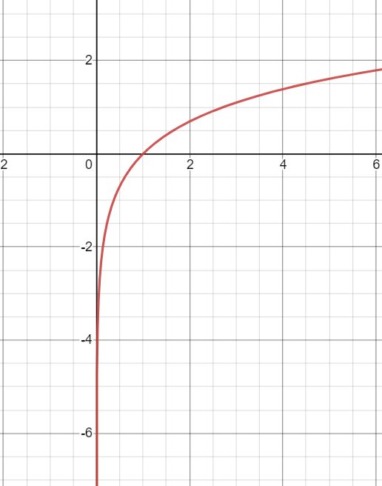
Why we have those outliers
1. Some inputs have a big loss because of very low prediction probability.
An example
Y_pred[-4] = [9.9981767e-01, 6.8540763e-15, 5.5824216e-07, 1.1135705e-11, 5.9789218e-13, 2.4447195e-09, 4.2163074e-06, 1.7761470e-04, 2.9714092e-14]
Y_true_hot[-4] = [0., 0., 0., 0., 0., 0., 0., 0., 1.]
The input loss: 1 * -log_e(0.000000000000029714) = 31.24
2. When using cross-entropy loss for classification, bad predictions are penalized much more strongly than good predictions are rewarded.
3. So even if many inputs are correctly predicted (low loss), a few misclassified inputs will have a high loss, hence "blowing up" your mean loss.
Conclusion: The current categorical cross-entropy is an inaccurate reflection of the model performance. We need to prevent these huge losses as they skew our mean loss.
Y = ln(x) function
Model 3

Slide 7
How can we prevent those huge losses?
Possible Solution
Idea: Categorical Cross-entropy loss is not a bounded loss.
Consequence: A single very wrong prediction can potentially make your loss "blow up".
Possible Solution: Make the categorical cross-entropy loss a bounded loss by setting the limit to be 3 standard deviations from the mean of the initial model loss because that is the worst case scenario, as it is random.

Slide 8
Work cited
https://stats.stackexchange.com/questions/282160/how-is-it-possible-that-validation-loss-is-increasing-while-validation-accuracy
https://stats.stackexchange.com/questions/258166/good-accuracy-despite-high-loss-value/448033#448033

